Slide 1
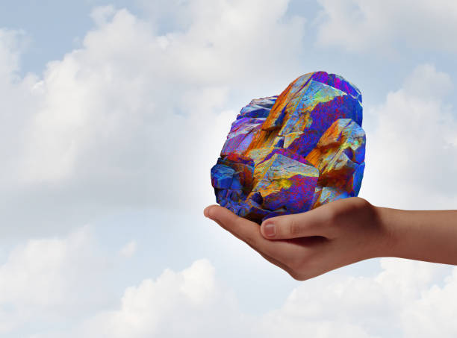


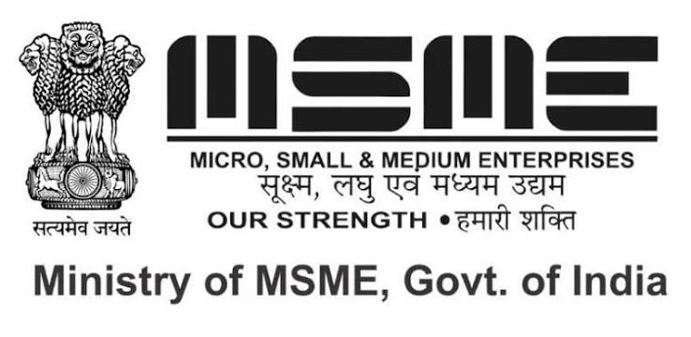
India International Strategic Minerals Expo (IISMExpo) - 2027
Organised by:
Supported by:
AMIGOCONNECT
Website: www.iismexpo.Com

Slide 2
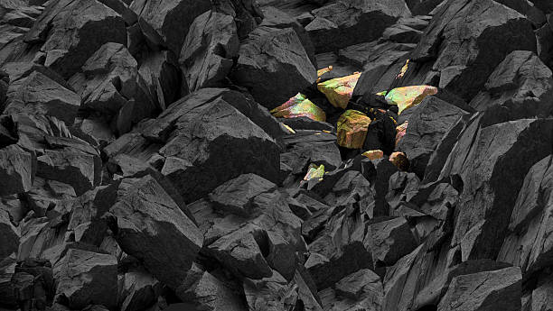
India International Strategic Minerals Expo (IISMExpo 2027)
Blueprint for India's Critical Mineral Future
A B2B, G2B Event Framework | National Critical Mineral Mission
India Mining Rare Earth Mineral Exhibition - 2027 is the definitive international platform for India's mining and mineral ecosystem.
The Mission:
Connect government, industry, finance, and technology to drive strategic, 21st-century mining priorities.
The Scope:
Cover the complete resource lifecycle—from exploration and processing to sustainable manufacturing, mine closure, and community transition.
Website: www.iismexpo.Com

Slide 3
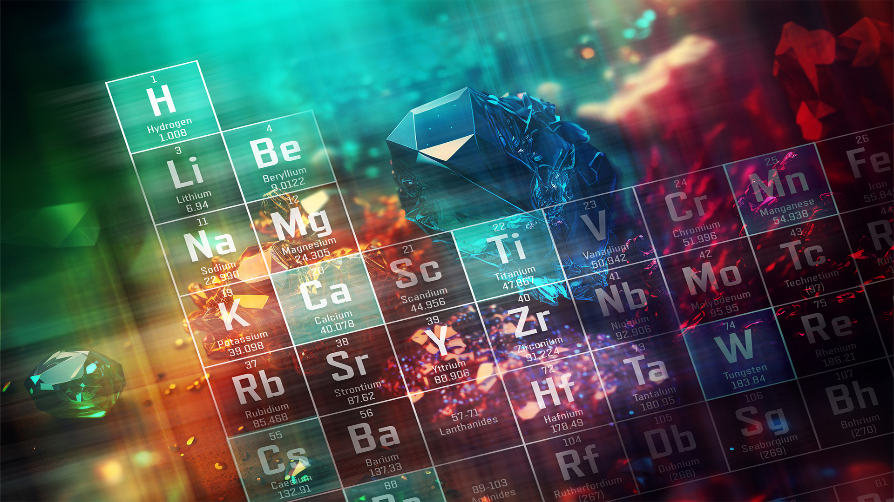

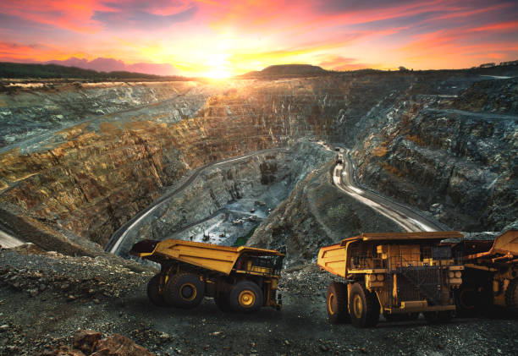
Strategic Vision & Objectives
Why Now?
• Aligns with India's National Critical Mineral Mission & Net-Zero targets.
• Secures supply chain resilience for high-tech industries and EV sectors.
• Promotes domestic exploration, refining, and urban mining innovations.
Key Event Goals
• Foster global tech transfer in REE exploration and processing.
• Attract foreign direct investment (FDI) and venture capital into mining.
• Create a unified B2B G2B platform for policymakers, PSUs, and private buyers.
Website: www.iismexpo.Com

Slide 4
About the Event
India International Strategic Minerals Expo (IISMExpo) – 2027 is India’s premier international exhibition dedicated to critical minerals, commodities, investment, clean energy, and low-carbon technologies. Hosted in Bharat Mandapam, New Delhi, India this landmark event unites the entire mineral resources value chain to drive the future of energy transition.
The Strategic Context
As India accelerates toward its 2070 net-zero target, the demand for essential minerals like lithium, nickel, cobalt, copper, graphite, and rare earth elements is skyrocketing. Facing tight domestic reserves and limited mining capacity, India is actively prioritising strategic stockpiling to safeguard industrial growth and ensure uninterrupted resource security.
National Critical Mineral Mission (NCMM)
To combat geopolitical supply risks and foster self-reliance, the Government of India has launched the National Critical Mineral Mission (NCMM). Backed by a massive budget exceeding ₹34,000 crores (USD 4 billion), this strategy aims to build a resilient, globally competitive critical minerals ecosystem encompassing:
Exploration & Mining
Beneficiation & Processing
Advanced Recycling & Recovery
The Pivotal Role of State Governments
This exhibition spotlights state governments as the bedrock of India's processing capabilities. As the primary implementing agencies, states are instrumental in:
Accelerating infrastructure development
Streamlining regulatory frameworks
Fostering industrial ecosystems for clean-energy manufacturing
Who Will You Meet?
The event will host 500+ senior-level executives from 20+ countries for three days of exhibition, strategic dialogue, business matching, and high-level networking. Key participating groups include:
Government delegations & policymakers
Global mining & energy corporations
Institutional investors & commercial banks
Cutting-edge technology providers
Industry associations & global stakeholders

Slide 5
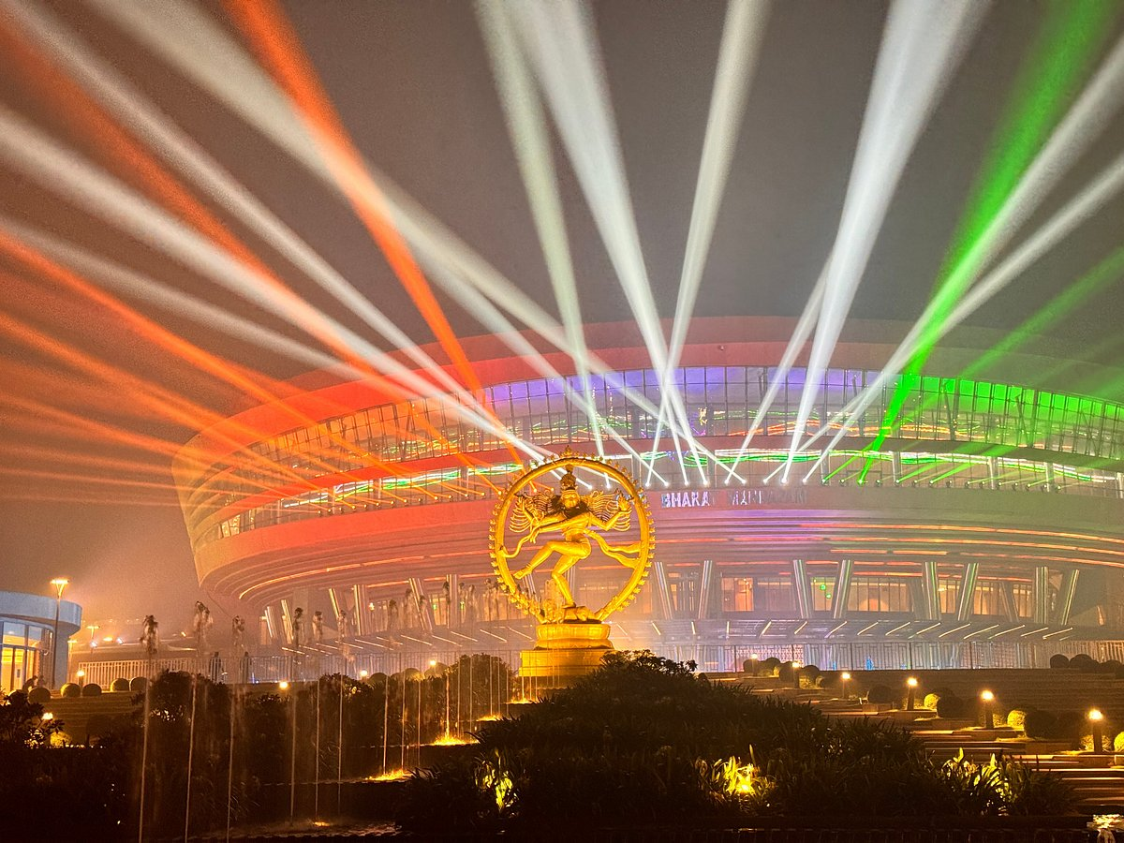
Venue
New Delhi | Bharat Mandapam, Pragati Maidan (IECC)
Website: www.iismexpo.Com

Slide 6
Sectors
Exploration & Mining Tech
AI mapping, advanced drilling rigs, deep-earth geophysical sensors.
Processing & Metallurgy
Chemical refining tech, pilot plant models, advanced metallurgy.
Strategic Applications
Permanent magnets, EV motors, defense systems, aerospace tech.
Circular Economy
E-waste urban mining, recycling tech, battery recovery systems.
1.Exploration & Extraction
This sector focuses on finding and pulling resources out of the ground.
Geological Exploration & Surveying: Companies specializing in remote sensing, core drilling, and geochemical mapping to locate mineral deposits.
Mining Operations: Open-pit and underground mining operations extracting raw ores (e.g., bastnäsite and monazite for rare earths, chalcopyrite for copper).
Mining Equipment & Machinery: Manufacturers of heavy earthmovers, drill rigs, crushing units, and automated mining systems like Caterpillar Mining.
2.Processing & Refining
Raw ore is virtually useless without intensive chemical and metallurgical processing to isolate pure metals.
Beneficiation & Concentration: Crushing, grinding, and froth flotation sectors that separate valuable mineral grains from waste rock (gangue).
Chemical Cracking & Hydrometallurgy: Acid leaching and solvent extraction plants specifically designed to separate individual Rare Earth Elements (REEs) like Neodymium, Dysprosium, and Praseodymium, which are chemically very similar and notoriously difficult to isolate.
Smelting & Alloying: Converting purified mineral concentrates into industrial metals and master alloys.
3.Advanced Manufacturing
This sector transforms processed minerals into the high-tech components that drive the modern economy.
Permanent Magnet Manufacturing: The largest sector for critical rare earths. Purified Neodymium-Iron-Boron (NdFeB) magnets are essential for Electric Vehicle (EV) drivetrains and wind turbine generators.
Clean Energy & Battery Storage: Production of lithium-ion batteries, fuel cells, and solar photovoltaics using cobalt, nickel, lithium, and copper.
Defence & Aerospace Technologies: Sectors utilizing rare earths and specialty titanium/nickel alloys for jet engines, missile guidance systems, satellites, and night-vision optics.
Electronics & Semiconductors: Utilization of critical minerals for polishing silicon wafers, creating micro capacitors, and manufacturing displays (using europium and yttrium for phosphors).
4. Cross-Cutting & Support Sectors
Mineral Recycling & Circular Economy: E-waste and battery recycling sectors focused on urban mining to recover secondary rare earths, copper, and cobalt.
Environmental & Waste Management: Companies managing tailings ponds, acid mine drainage mitigation, and sustainable mine closures.
Commodity Trading & Investment: Financial institutions, metal exchanges, and venture capital firms funding resource exploration and strategic stockpiling.

Slide 7
Target Audience & Ecosystem Mapping
Exhibitor Profiles
• Global Mining Technology Providers
• Heavy Machinery & Refining Equippers
• Geological & Software Engineering Firms
• E-Waste Processing Innovators
Website: www.iismexpo.Com

Slide 8
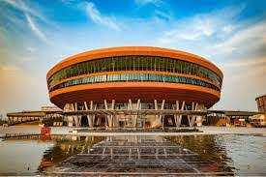
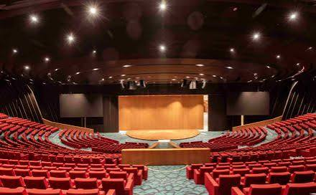
Conference Agenda:
Location: Bharat Mandapam, New Delhi
Day 1:
Bidding & Block Allocation
Supply Chain De-risking
Sustainable 'Green' Mining
Day 2:
Policy, Investment & Global Trade.
Exploration, Technology & Processing
Clean Energy & Low-Carbon Integration
Downstream Manufacturing & Recycling
Website: www.iismexpo.Com

Slide 9

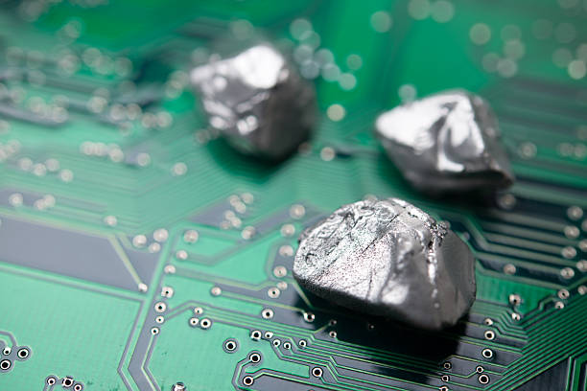
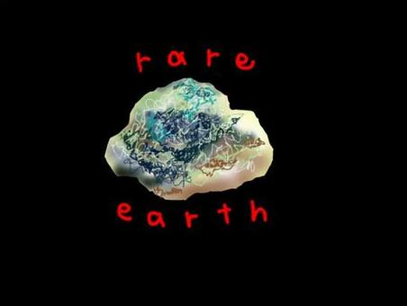
Securing India's Resource Independence
Let's collaborate to build a resilient critical mineral future.
For More Details and Exhibition Participation
Padam Sharma
9971587831, 9220803001
Email: padam@amigoconnect.Com
Website: www.iismexpo.Com
AMIGOCONNECT
India International Strategic Minerals Expo (IISMExpo) - 2027

